Slide 1
Using E-notes
Making sure that you are not Plagiarizing

Slide 2
What are E-notes?
Electronic notes in which information for a topic is gathered.
A place to record your sources.
A place to put the information into point form.

Slide 3
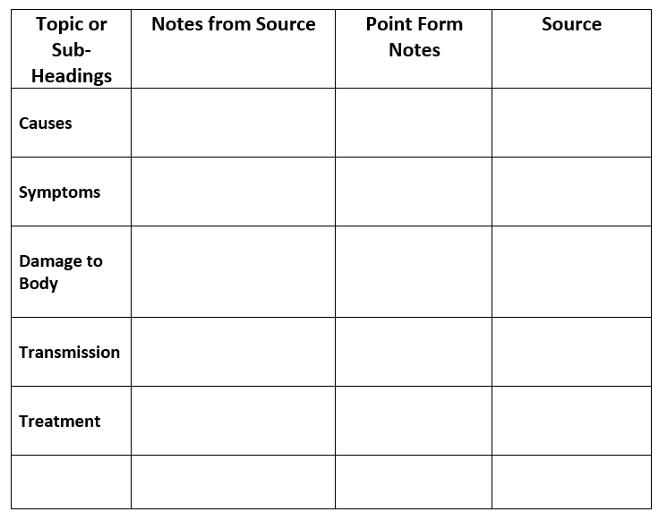
Researching a Disease
Find your information
Copy the relevant pieces into the Notes from Source column.

Slide 4
Find a good article: Copy relevant info

Slide 5
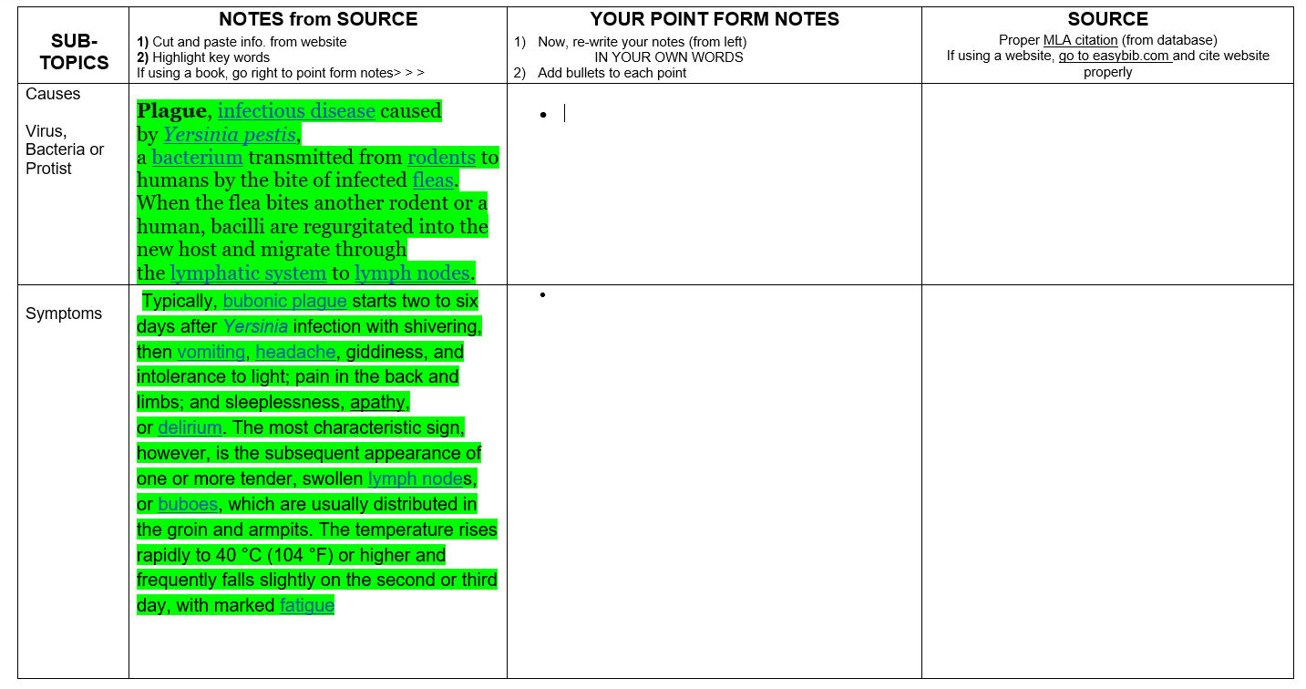
Notice that your article may contain information for more than one section

Slide 6
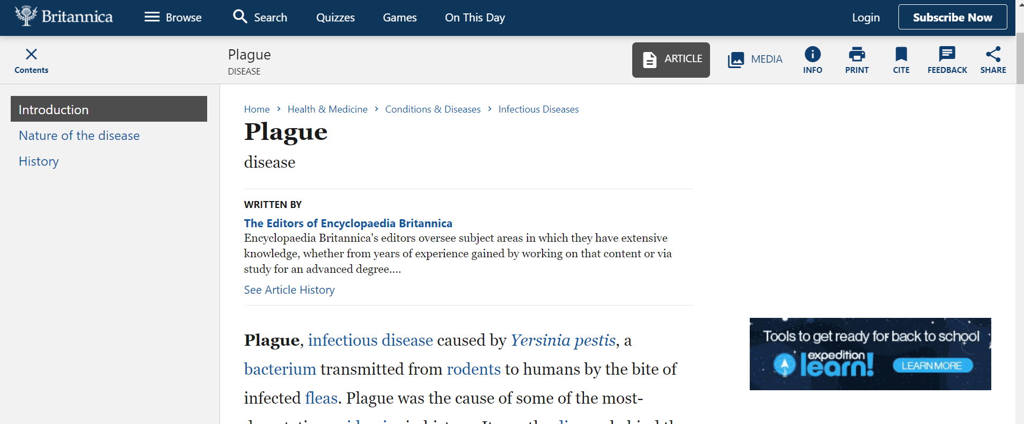
Click on CITE

Slide 7
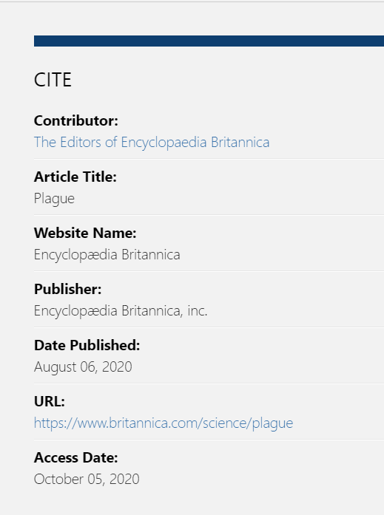
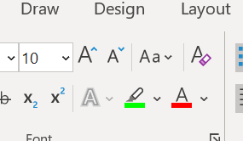
Citations
Copy this information into the sources section of your E-notes.
To do this select the info. Then right click on your mouse and click COPY.
Go to your document and right click on PASTE.
Then colour code the information from that source using the highlighter function.

Slide 8
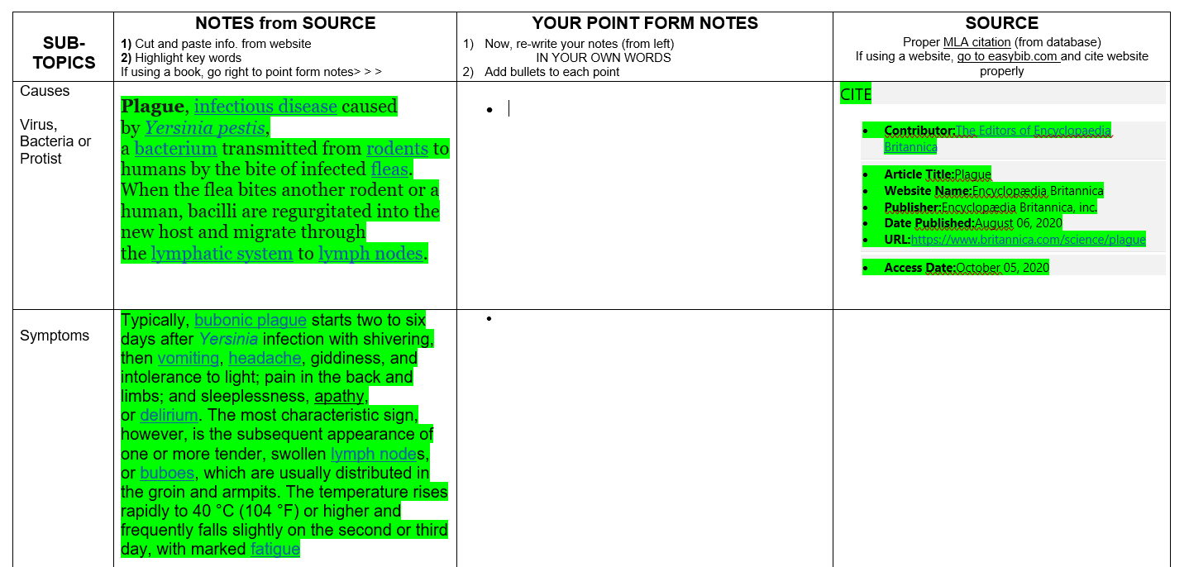

Slide 9
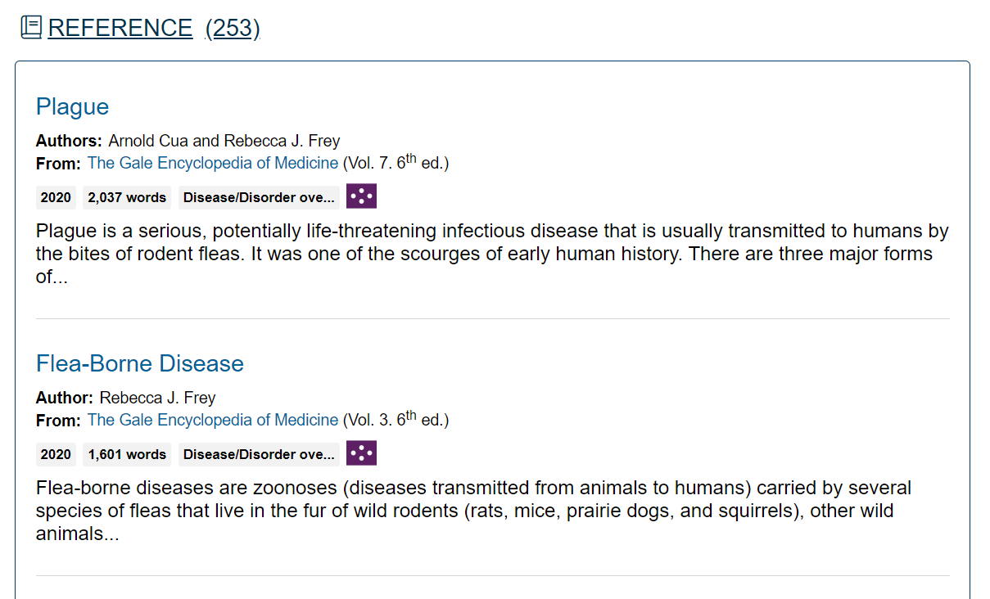
More Sources
You always need multiple sources to ensure that the information is accurate.
So, go find another article.
This time we are going to go to the data bases and use Science in Context.
I searched for Bubonic Plague and found these.

Slide 10
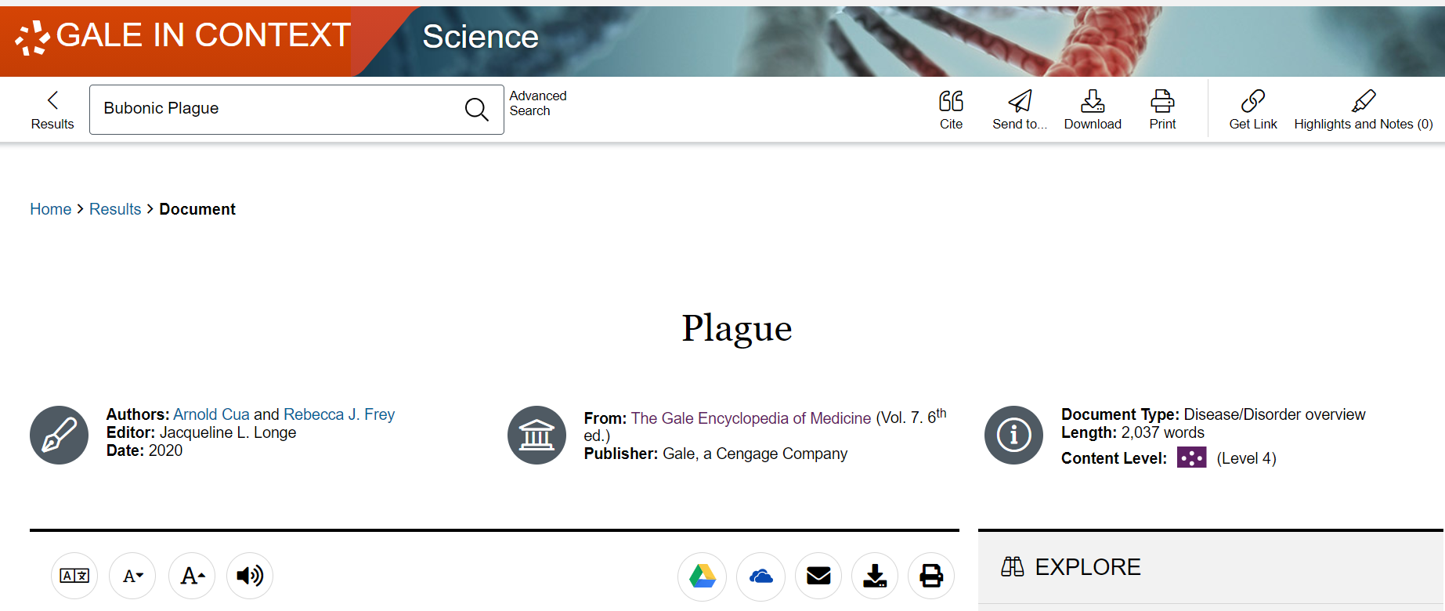
You need multiple sources
This is the first article from the previous page.

Slide 11
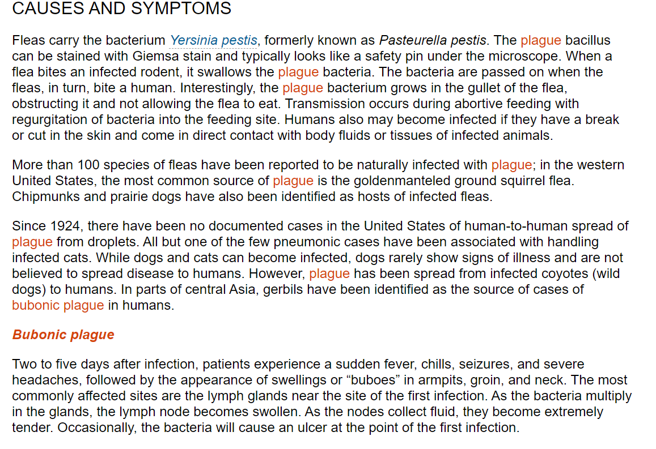
Gather More Info
Gather More Information from your second source…
Scroll down to Causes and Symptoms
Copy what is relevant into your E-Note Chart and colour code it.

Slide 12
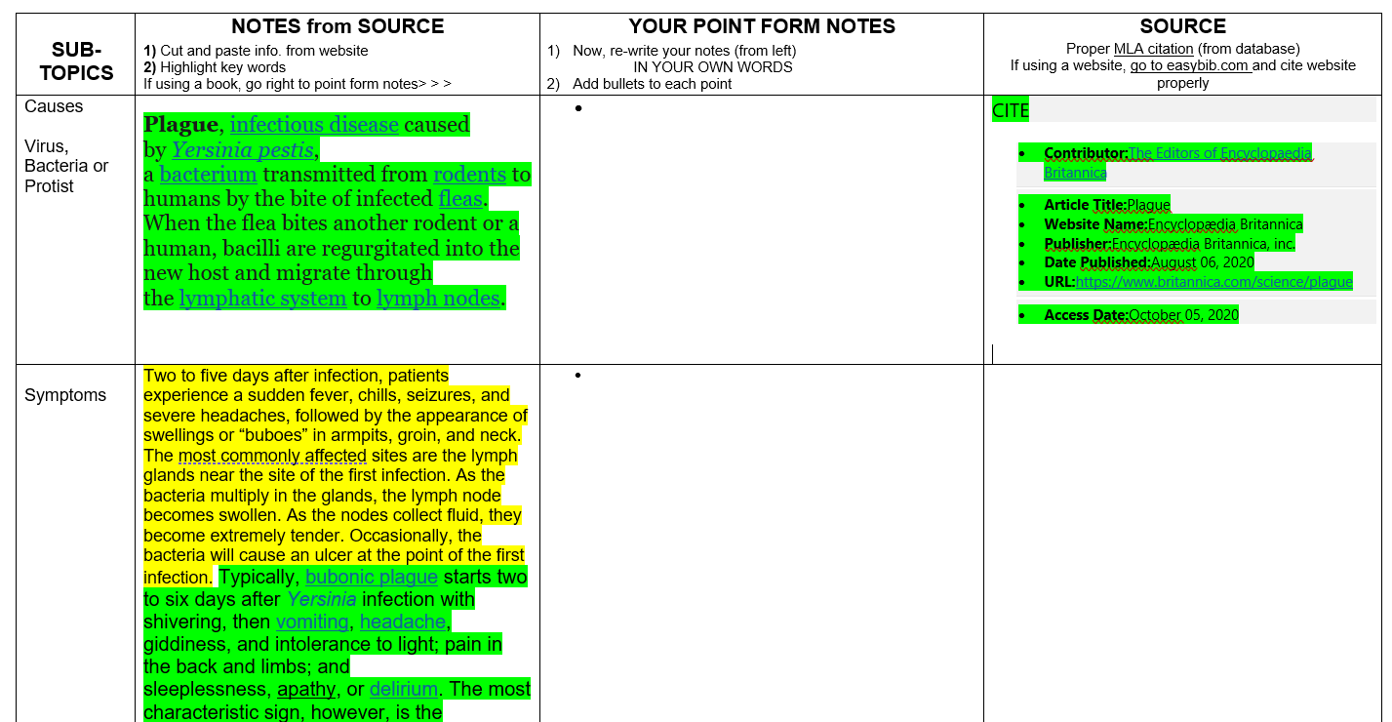

Slide 13
Now you need to make sure you record your source.
Click here

Slide 14
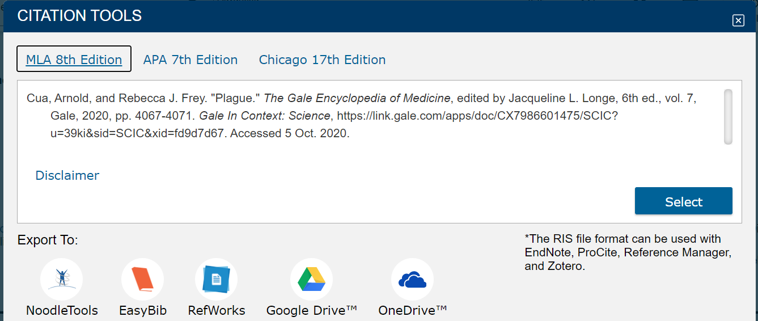
Click SELECT and then Copy by right clicking your mouse.

Slide 15
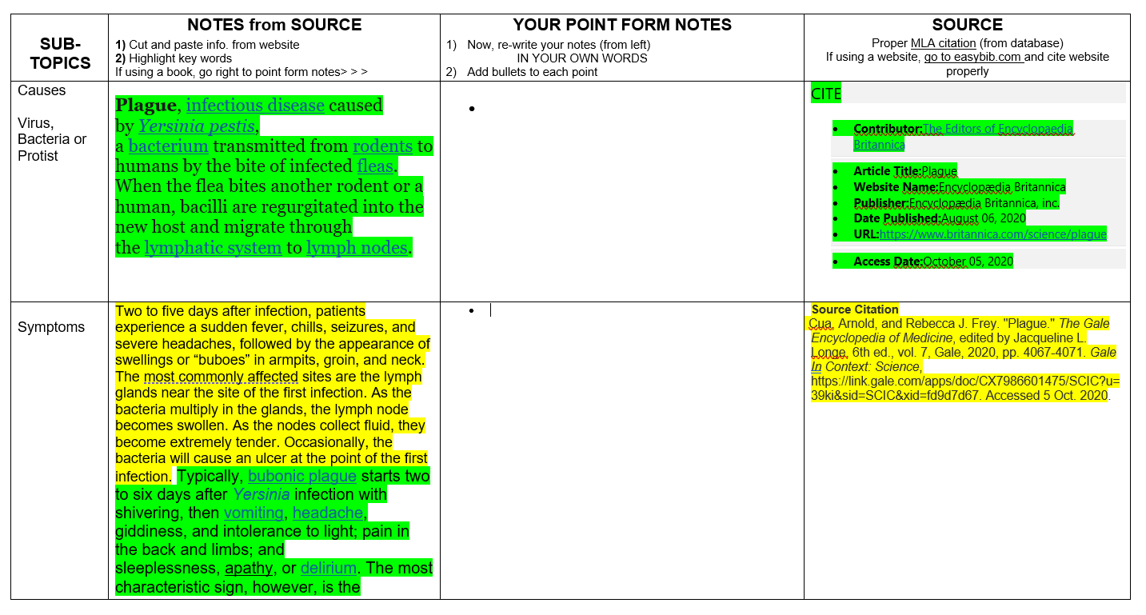
Paste your source citation here.

Slide 16
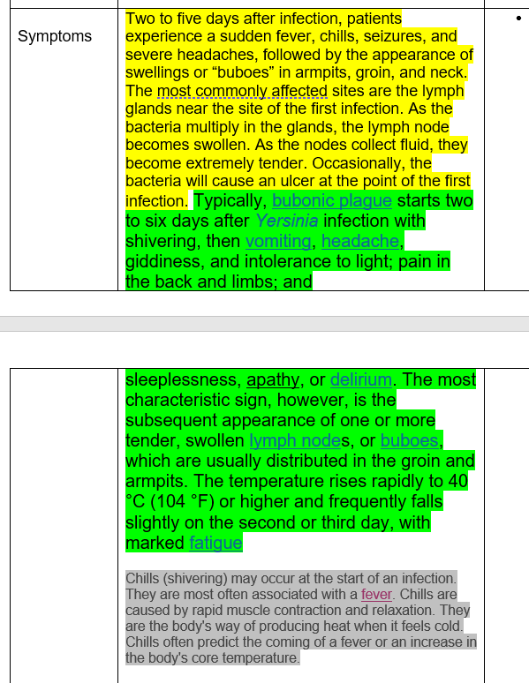
Multiple Sources per Topic
Make sure that you have multiple sources per topic.
Notice that for symptoms, there are three different colours, which means that I have found information from three different sources.
This is our goal.

Slide 17
Putting the information into your own words.
Now that you have all of your information you can begin to put this into your own words.
To do this, put the information that you have copied into note form in the point form notes column.

Slide 18
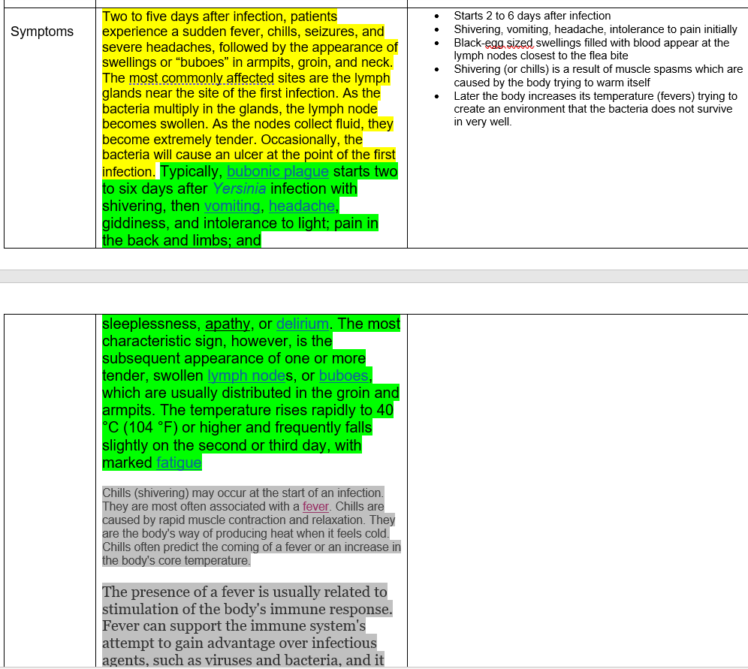
Making Notes
ADD BULLET POINTS​
Do not write sentences
ADD BULLET POINTS​
Do not write sentences
Use as few words as possible.
Remove any extra words such as a, an, the etc.
Use abbreviations wherever possible.
Use BULLET POINTS
DO NOT write sentences

Slide 19
Your E-notes are complete!
Upload a copy of these in the Assignment section of TEAMS.

Slide 20
Final Assignment
Do
AFTER you have completed your E-notes!
Go
to the last page of your Life and the Cell package.
Fill in
the sheet either electronically or by hand. You will do this by changing your point form notes back into sentences.
Make
sure you are only using the point form notes. Ignore the rest.
Don’t forget
to record your sources at the end. You should have more than three so just add another sheet of paper for the rest of the sources.

